Slide 1
Chapter 7
Unemployment

Slide 2
Introduction
Unemployment and output are tightly linked – but the link is not perfect
Unemployment is a lagging economic indicator
  Can be a mistaken guide to policy
  Rising GDP may be of little solace to those still without a job
Costs of unemployment not equally distributed

Slide 3
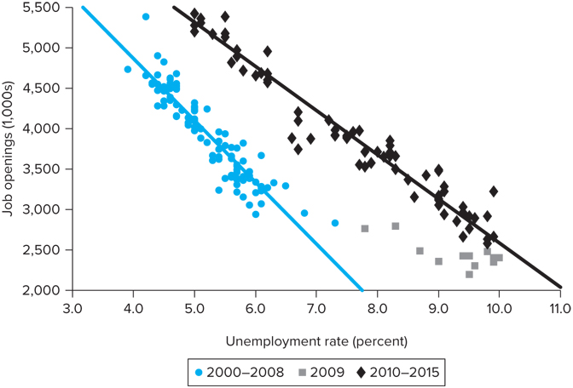
The Beveridge Curve
Finding a job takes time
Job matching process illustrated by the Beveridge Curve which shows unemployment rate vs. number of job openings
During Great Recession and years following unemployment high, but job vacancies higher in period following recession

Slide 4
The Anatomy of Unemployment
Five key characteristics of unemployment in the U.S.:
  There are large variations in unemployment rates across groups defined by age, race, or experience.
  There is high turnover in the labor market. Flows into and out of employment and unemployment are high relative to the numbers of employed or unemployed.
  A significant part of this turnover is cyclical: Layoffs and separations are high during recessions, and voluntary quits are high during booms.
  Most people who become unemployed in any given month remain unemployed for only a short time.
  Much of the U.S. unemployment consists of people who will be unemployed for quite a long time.

Slide 5
The Anatomy of Unemployment
The size of the labor force (unemployed (U) + employed (E))is determined from surveys by the BLS
Unemployed is one who is out of work and who either
  Has actively looked for work during the previous 4 weeks OR
  Is waiting to be recalled to a job after having been laid off
Table 7-1: U.S. Labor Force and Unemployment, 2015 (Millions of Persons 16 Years and Over)
Working-age population | 250.8
Labor force | 157.1
Employed | 148.8
Unemployed | 8.3
Not in labor force | 93.7
Source: Bureau of Labor Statistics
Notes:
Source: Bureau of Labor Statistics.

Slide 6
The Anatomy of Unemployment
Employed person is one who during the reference week:
  Did at least one hour of work for pay in the last week
  Worked at least 15 hours as an unpaid worker for an enterprise owned by a family member OR
  Was not working, but only temporarily absent from work (ex. vacation or maturity leave)
Table 7-1: U.S. Labor Force and Unemployment, 2015 (Millions of Persons 16 Years and Over)
Working-age population | 250.8
Labor force | 157.1
Employed | 148.8
Unemployed | 8.3
Not in labor force | 93.7
Source: Bureau of Labor Statistics

Slide 7
The Unemployment Pool
At any point in time there is a given number (pool) of unemployed people
There are flows in and out of the unemployment pool
A person can become unemployed for one of four reasons:
    He/she may be a new entrant or reentrant into the LF
    The person may quit a job in order to look for other employment and may register as unemployed while searching
    The person may be laid off
    The worker may lose a job (fired or firm closes)

Slide 8
The Unemployment Pool
There are three ways of moving out of the unemployment pool:
    A person may be hired into a new job
    Someone laid off may be recalled
    An unemployed person may stop looking for a job, and thus move out of the labor force
Unemployment is rising when more people are entering the pool than leaving
Job losses account for half of new unemployment; voluntary separations, new entrants, and reentrants into the LF account for the other half

Slide 9

Variation in Unemployment Across Groups
The aggregate unemployment rate tells us the share of the labor force that is unemployed
The aggregate number conceals wide variations across various segments of the population
  Teenagers have much higher unemployment rates than older workers
  Black unemployment is higher than that of their white cohorts
  Female unemployment was higher than male unemployment through the 1970s, but now lower than male unemployment
The relationship between the aggregate unemployment rate, u, and that of groups is: (1), where w_{i} are the fraction of the civilian LF that falls within a specific group

Slide 10
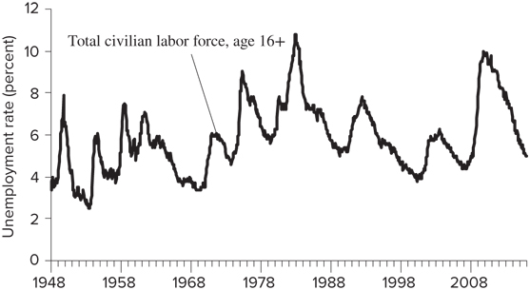
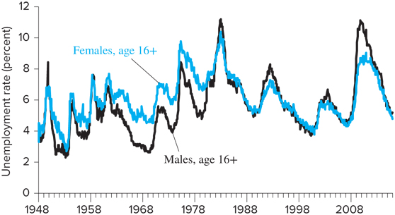
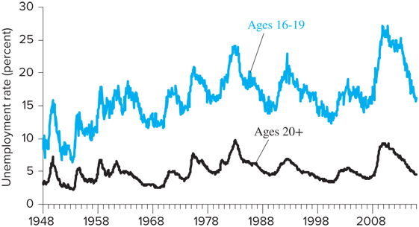
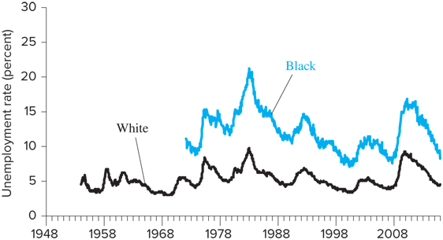
Variation in Unemployment Across Groups

Slide 11
Cyclical and Frictional Unemployment
Frictional unemployment is the unemployment that exists when the economy is at full employment
  Results from the structure of the labor market, including:
    The nature of jobs in the economy
    Social habits
    Labor market institutions
Frictional unemployment rate = natural rate of unemployment
Cyclical unemployment is unemployment in excess of frictional unemployment
  Occurs when output is below the full employment level
  The presence of cyclical unemployment indicates a downturn in the economy

Slide 12
Labor Market Flows
Labor market turnover, flows into and out of unemployment and employment and between jobs, is large
Table 7-2 shows the average of monthly flows in 2012 into and out of employment within the manufacturing sector
Table 7-2 Labor Turnover Rates in Manufacturing, 2015 (Per 100 Employees; Average of Monthly Data)
Accessions | Separations
Hires | Quits | Layoffs* | Other | Total
2.1 | 1.1 | 0.8 | 0.2 | 2.1
*Includes involuntary separations.
Source: Bureau of Labor Statistics, Job Openings and Labor Turnover Survey.

Slide 13
Duration of Unemployment
Another issue to consider when examining unemployment is the duration of unemployment spells
A spell of unemployment is a period in which an individual remains continuously unemployed
The duration of unemployment is the average length of time a person remains unemployed

Slide 14
Table 7-3: Unemployment by Duration
Length of Unemployment, Weeks | Percent of Unemployed
 | 2006 | 2009 | 2015
Less than 5 | 37.3 | 22.2 | 28.9
5-14 | 30.3 | 26.8 | 27.7
15-26 | 14.7 | 19.5 | 15.3
27-51 | 7.6 | 15.2 | 9.4
52 and over | 10.0 | 16.3 | 18.6
Mean number of weeks | 16.8 wk. | 24.4 wk. | 29.2 wk.
Median number of weeks | 8.3 wk. | 15.1 wk. | 11.6 wk.
Unemployment rate | 4.6 | 9.3 | 5.3
Source: Bureau of Labor Statistics

Slide 15
Determinants of the Natural Rate
The determinants of the natural rate of unemployment, u*, can be thought of in terms of the duration and frequency of unemployment
The duration of unemployment depends on cyclical factors and on the following structural characteristics of the labor market:
  The organization of the labor market, including the presence or absence of employment agencies, youth employment services, etc.
  The demographic makeup of the labor force
  The ability and desire of the unemployed to keep looking for a better job, which depends in part on the availability of unemployment benefits

Slide 16
Determinants of the Natural Rate
The determinants of the natural rate of unemployment, u*, can be thought of in terms of the duration and frequency of unemployment
The frequency of unemployment is the average number of times per period that workers become unemployed
Two basic determinants of the frequency of unemployment:
  Variability of the demand for labor across different firms in the economy
  The rate at which new workers enter the labor force, since new potential workers begin as unemployed workers
The determinants of duration and frequency of unemployment are the basic determinants of the natural rate of unemployment

Slide 17
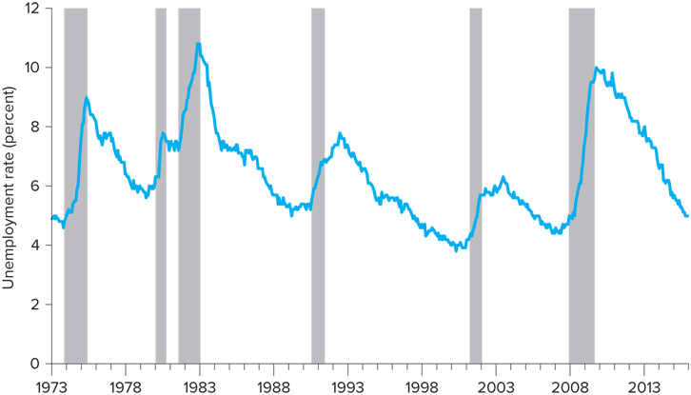
Determinants of the Natural Rate

Slide 18
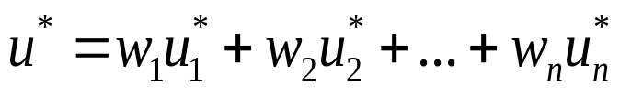
Estimates of the Natural Rate
The equation for the natural rate of unemployment is similar to equation (1): (2)
Equation (2) says that the natural rate is the weighted average of the natural rates of unemployment of the subgroups in the LF
Several adjustments are needed to account for:
  Changing composition of the LF, including increasing share of teenagers
  Changes in the fundamental determinants of the natural rate, including unemployment benefits

Slide 19
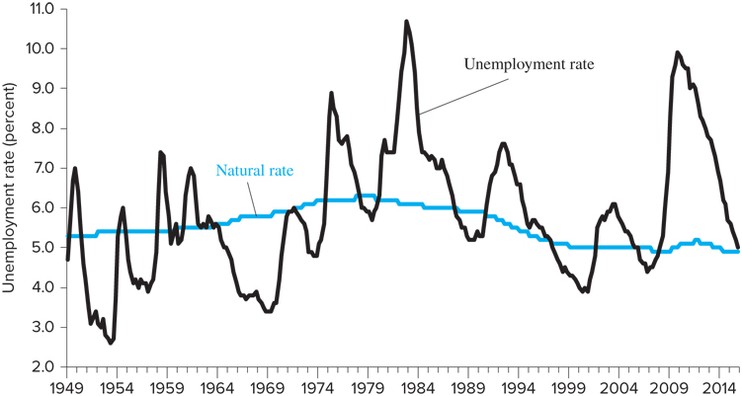
Estimates of the Natural Rate
The Congressional Budget Office (CBO) provides an official full-employment-unemployment rate estimate
If actual unemployment rate is above natural rate, u > u* and Y < Y*
If actual unemployment rate is below natural rate, u < u* and Y > Y*

Slide 20
Hysteresis and the Rising Natural Rate of Unemployment
Between 1973 and 1988 the U.S. unemployment rate stayed well above the natural rate estimated using the demographic adjustment method
Some economists argue that the unemployment rate over long periods cannot move too far from the natural rate → the natural rate must have increased over this time period
WHY?

Slide 21
Hysteresis and the Rising Natural Rate of Unemployment
One explanation is unemployment hysteresis: extended periods of high unemployment raise the natural rate
Unemployed might become accustomed to not working
Unemployed could become discouraged and not vigorously seek work
Long unemployment spells might signal to firms that a worker is undesirable, and the firms might avoid hiring such workers

Slide 22
Unemployment Benefits
Unemployment benefits increase the rate of unemployment in two ways:
    Unemployment benefits allow for longer job searches
    Lessens the severity of being in and out of jobs
Unemployment benefits increase the measured unemployment rate through reporting effects
In order to collect unemployment insurance, a person must be considered “in the labor force,” or actively seeking work → some seek work even if they do not really want the job to be counted as unemployed
One estimate suggests that reporting effects raise the unemployment rate by about half a percentage point

Slide 23
The Costs of Unemployment
Unemployed persons suffer both from their income loss and from the related social problems that long periods of unemployment cause
Costs of cyclical unemployment:
  Okun’s law tells us that every 1 point increase in unemployment reduces output by 2 % points
  Distributional impact of unemployment may be more dire for some groups than others (Ex. Teenagers vs. older workers)
  In addition to lost output from unemployment, there is reduced tax revenues
Social costs of unemployment:
  Include increased divorce rates, suicide rates, and depression

